Slide 1
The European Social Survey in Latvia:
Insights from Face-to-Face to Self-Completion Survey Mode Сomparison
Jurijs Ņikišins
ESS National Coordinator in Latvia

Slide 2
2
European Social Survey: Overview
First funded in 2001 Funded by the European Commission, following preparatory work by Roger Jowell and Max Kaase at the European Science Foundation
Academic cross-national survey Measuring attitudes, behaviour, and demographics of people in Europe (but also incl. Israel, Turkey, Ukraine etc.)
10 rounds completed Every two years since 2002/03 - in 39 participating countries
Face-to-face interviews R1-9 The questionnaire lasts one-hour and has been translated into 50 languages
Self-completion methods in R10 Due to the pandemic, national teams could implement self-completion methods in Round 10 for the first time
All data free for non-commercial use Available to download from the ESS Data Portal in a range of file formats for statistical software programmes
Over 215,000 registered users More than 65% students
6,585 academic publications Journal articles, books, working and conference papers that analysed our data have been published (2003-22)

Slide 3
3
European Social Survey: Core Scientific Team (CST)
HQ: City, University of London (UK)
Centerdata (Netherlands)
GESIS - Leibniz Institute for the Social Sciences (Germany)
Sikt - Norwegian Agency for Shared Services in Education and Research (Norway)
SCP - The Netherlands Institute for Social Research (Netherlands)
Universitat Pompeu Fabra (Spain)
University of Essex (UK)
University of Ljubljana (Slovenia)
4
1
7
5
2
3
8
6

Slide 4
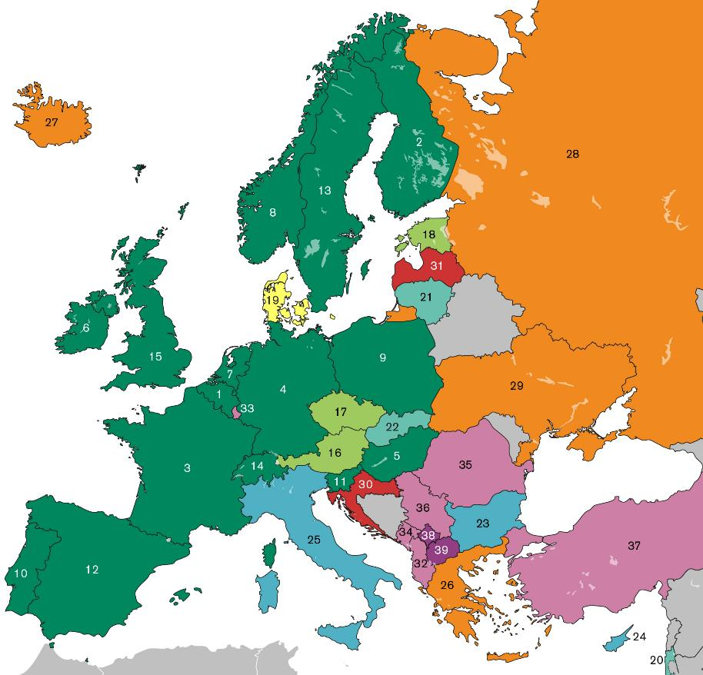
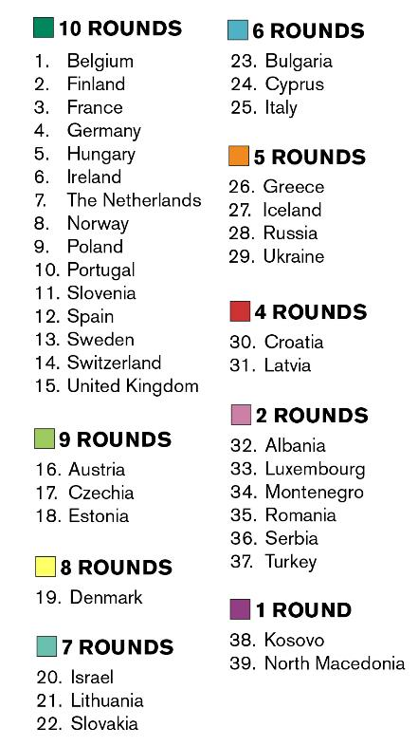
4
Participating countries

Slide 5
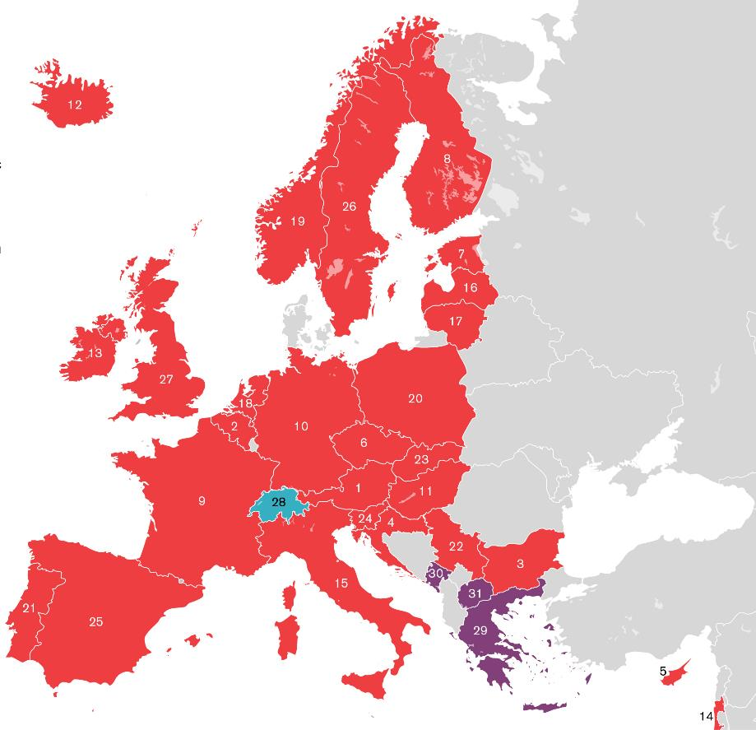
5
Round 10 (2020-22)
31 participating countries
Complications with fieldwork due to pandemic
Several countries switched to self-completion modes
Extended fieldwork period: September 2020 – May 2022
Weighted data now available for 30 countries
Separate datasets: Face to face & Self-completion

Slide 6
6
Questionnaire
CORE MODULES
Media/Internet use, social trust 6 questions
Political interest, trust in others / institutions, electoral and other forms of participation, party allegiance, socio-political orientations, immigration 43 questions
Subjective wellbeing, social exclusion, crime, religion, perceived discrimination, national and ethnic identity, vote intention in EU referendum 35 questions
Socio-demographic profile: household composition, sex, age, marital status, type of area, education & occupation of respondent, partner, parents, union membership, income and ancestry 35 questions
Human Values Scale 21 questions
ROTATING MODULES Two sections of 30 questions on a single academic and/or policy concern within Europe

Slide 7
7
Rotating modules (Round 9, 2018/19)
Timing of Life 35 questions
Repeated from Round 3 (2006/07)
The life course and timing of key life events;
Age: leave education, become adult, leave family home, live with partner, married, have children, retire, become grandparent;
Attitudes towards the ideal age, young people, old people.
Justice and Fairness 32 questions
Brand new module
Political procedural justice;
Fairness of: income, educational and job opportunities, distribution of resources;
Attitudes towards normative principles, social closure;
Belief in a just and fair world.

Slide 8
8
Rotating modules (Round 10, 2020-22)
Understandings and Evaluations of Democracy 32 questions
Repeated from Round 6 (2012/13)
Fair elections/courts, justice system hold government to account;
Attitudes towards political parties, minority groups, voting in referendums;
Government responsibility to protect against poverty/reduce income inequality.
Digital Social Contacts in Work and Family Life 36 questions
Brand new module
Internet access/skill and smartphone use;
Intergenerational contact;
Contact at work, remote working, expectations at work, job satisfaction, work-life conflict.

Slide 9
9
Coronavirus questions (Round 10, 2020-22)
ESS COVID-19 Module 20 questions
Brand new module
Fielded instead of country-specific questions;
10 questions developed by national coordinators and the CST.
Government authority and legitimacy in the age of a pandemic
Proposed by a team led by Marc Helbling (University of Bamberg);
5 questions measuring attitudes towards government responses to COVID-19.
COVID-19 conspiracy beliefs and government rule compliance
5 questions proposed by Kostas Gemenis (Max Planck Institute for the Study of Societies).

Slide 10
10
ESS non-academic impact: selected examples
Finland: The ESS survey design and data were used in evaluating the Universal Basic Income (UBI) trial in Finland, among the largest such trials in the world to date. The module on social trust from Round 9 was filled by the sample and a control group to compare with the data collected among the ESS sample in 2018.
Latvia: The Latvian government has asked the National Coordinator of ESS in Latvia to carry out an in-depth analysis of social and political trust in Latvia. The project’s title is ‘Anatomy of Trust – What European Social Survey Data Tell About Trust in Latvia’. The research will feature into the National Development Plan for 2021-2027, which is drawn up by the Cross-Sectional Coordination Center of Latvia, which directly answers to the Prime Minister.
Lithuania: The Lithuanian Strategy for Demography, Migration and Integration Policy 2018–2030 references the ESS Round results to support strengthening Lithuanian NGOs and community organisations in order to foster stronger communities. The Lithuanian NC is preparing an analysis of how ESS data could contribute towards existing Lithuanian strategies and their findings are planned to be presented in autumn-winter of 2021).
Hungary: At the start of the COVID-19 pandemic there was limited information in Hungary concerning the make-up of the elderly population. The core study team used the ESS to examine the social relationships of people aged 65 and over and warned of the potential impact that quarantine rules would have on this group. This report was widely reported in the Hungarian press, with many calling for more societal support for people in situations of loneliness and isolation.
Notes:
These are some emerging examples from our country correspondents. We are finding several more, with a few still to be confirmed or further explained in additional interviews/email exchanges. This and the next slide are intended to illustrate the range and different types of impacts we are finding (in addition to those already known from the 2016/17 impact study). We stress that mom-academic impacts are best reported via examples of this type rather than quantitative indicators.

Slide 11
11
ESS sampling and data collection comparison: R10 vs. R9
 | ESS R 9 | ESS R 10
Timespan | May 2018 - February 2020 Fieldwork: October 2019 - January 2020 | December 2020 – March 2022 Fieldwork: November 2021 – February 2022
Sampling and respondent selection | Stratification: by region (6) and territory type (cities, towns, rural) Three-stage cluster sampling of households and random selection of one respondent per household. Gross sample size: 2525 Stage 1: List of dwelling clusters (505) derived from the frame of dwellings Stage 2: Five dwellings in each cluster Stage 3: One person in each sampled dwelling using Kish grid method | Stratified systematic sampling of persons from the Population Register with equal probabilities in each stratum. Gross sample size: 4400 Explicit stratification gender and age group (14 strata) Implicit stratification by region, area type, territory code, city neighbourhood, building and dwelling id numbers (according to the officially declared place of residence).
Planned gross sample | 2525 | 4400
Achieved net sample (completed and valid interviews | 919 | 1023
Data collection mode | Face-to-face survey with interviewers traveling to respondents' residence | Self-completion survey: online (web questionnaire on Qualtrics) by post (paper questionnaire sent) no interviewers involved
Respondent incentives | Souvenirs (e.g. pens with survey agency logo) | Unconditional: lottery tickets; conditional: 7 EUR retail chain electronic vouchers
Survey Agency | Kantar TNS (private survey company) | Statistics Latvia (governmental institution)
Notes:
These are some emerging examples from our country correspondents. We are finding several more, with a few still to be confirmed or further explained in additional interviews/email exchanges. This and the next slide are intended to illustrate the range and different types of impacts we are finding (in addition to those already known from the 2016/17 impact study). We stress that mom-academic impacts are best reported via examples of this type rather than quantitative indicators.

Slide 12
12
ESS Round 10 survey participation – response rates
Paper
Web
Overall response rate was 28.25%, against a target of 25%, a total N=1243 (incl. incomplete interviews).
80.5% of total responses were received on web, vs. 19.5% on paper.
Notes:
Please edit the highlighted text and ‘Edit Data’ in the slide template to reflect the following information for your country:
Overall response rate
Web response rate
Paper response rate
Proportion of total responses received on web and on paper
Target response rate
Sample size
To edit the data in the chart to reflect your figures, click inside the chart, then select ‘Chart Design’ at the top of the window, then select ‘Edit Data’ within the Chart Design menu.

Slide 13
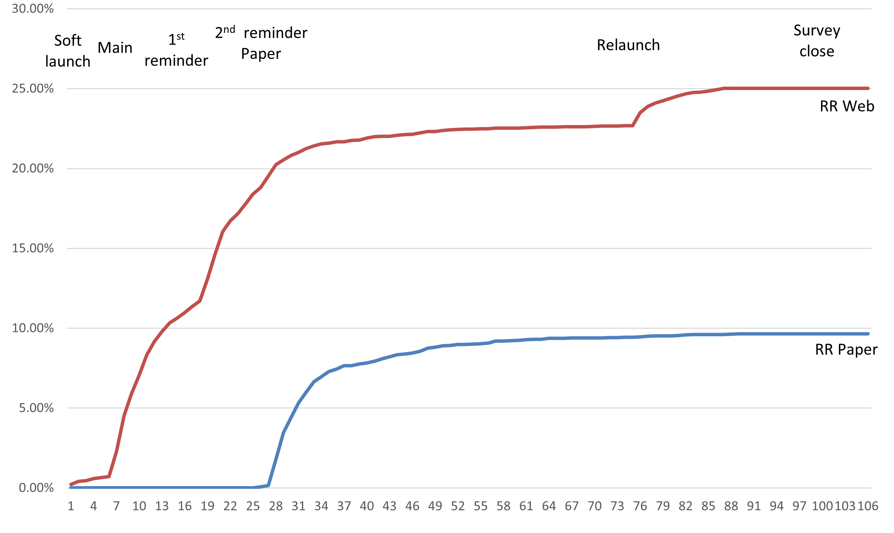
13
ESS R 10 response rate over time – invitations & reminders
Notes:
Please edit the slide template to reflect the responses received over the fieldwork period in your country:
Web response rate
Paper response rate,
documented by day of fieldwork (x-axis), and with the mailing dates (and fieldworker follow-up periods, if relevant) flagged by vertical arrows, as shown.

Slide 14
14
ESS R10 survey participation – questionnaire completion time
Expected survey length was 50 minutes.
Data from the web completion shows the following for Latvia: (capped at minimum 17 minutes and maximum 440 minutes):
Mean 75.7 minutes
Median 64.1 minutes
Notes:
Please edit the highlighted text in the slide template to reflect the following information for your country:
Mean interview length (excluding outliers)
Median survey length (excluding outliers).

Slide 15
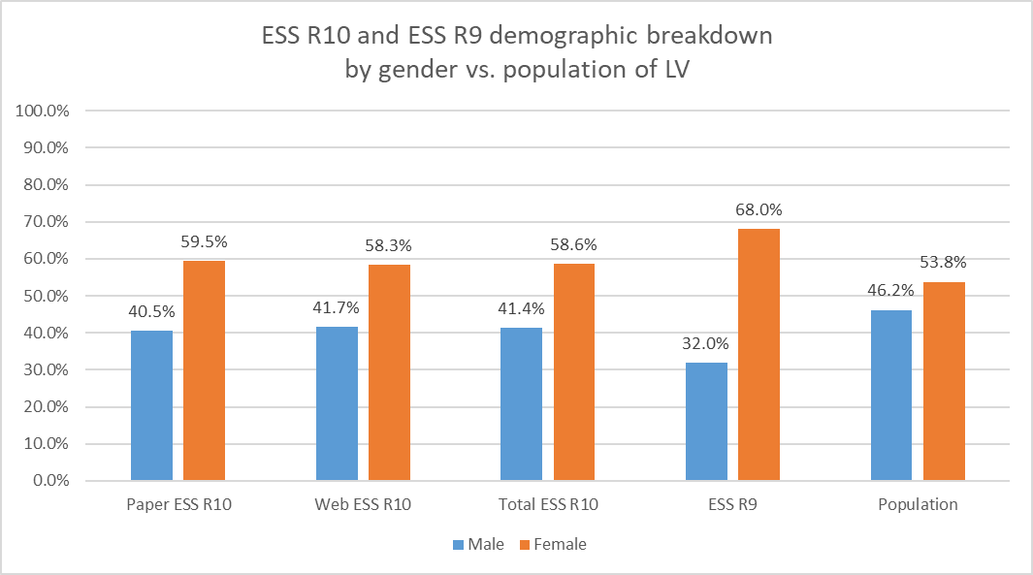
15
ESS R10 vs. ESS R9 vs. population demographic breakdown by gender
Notes:
Please edit the highlighted text in the slide template to reflect the following information for your country:
Breakdown of male/female respondents in Round 10, by mode;
Breakdown of male/female respondents in Round 9 (unweighted data);
Breakdown of male/female respondents in the national population statistics.

Slide 16
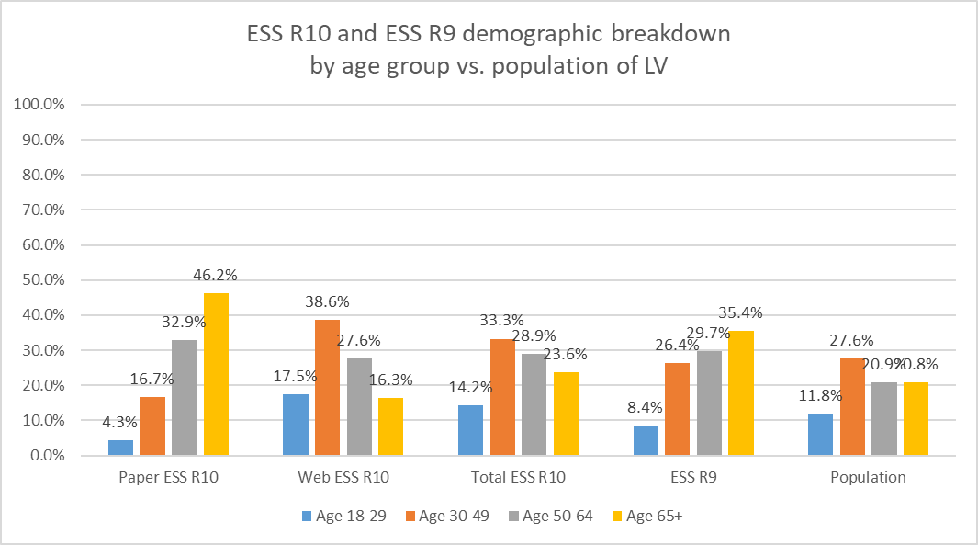
16
ESS R10 vs. ESS R9 vs. population demographic breakdown by age group
Notes:
Please edit the highlighted text in the slide template to reflect the following information for your country:
Breakdown of respondents by the specified age bands in Round 10, by mode;
Breakdown of respondents by the specified age bands in Round 9 (unweighted data);
Breakdown of respondents by the specified age bands in the national population statistics.

Slide 17
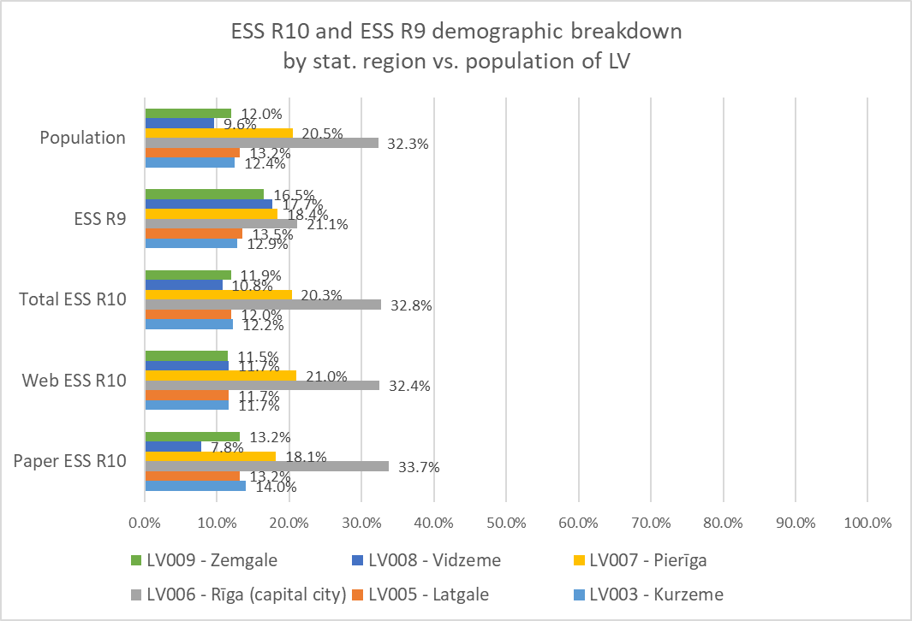
17
ESS R10 vs. ESS R9 vs. population demographic breakdown by region
Notes:
Please edit the highlighted text in the slide template to reflect the following information for your country:
Mean (and standard deviation) years of education of the respondents in Round 10, by mode;
Mean (and standard deviation) years of education of the respondents in Round 9 (unweighted data);
Mean (and standard deviation) years of education of the respondents in the national population statistics.

Slide 18
18
ESS Round 9: main challenges, ups and downs
Face-to-face mode; interviewers crucial in building contact & rapport with respondents; lesser risk of skipping & ignoring questions
Address selection problems; imperfect accuracy due to reliance on data of declared place of residence which in ~20 per cent of cases does not correspond to where people actually live
ESS interviewer workload requirements: 48 sample units per 1 interviewer. Rather hard to comply with in a small country with a limited number of skilled interviewers
Questionnaire volume and fill-in time (average 1 h 15 mins; ~300 questions); greater burden on respondents than in most surveys in Latvia
Underrepresentation of males (32% in the sample vs. 46% in the population)
Underrepresentation of younger age groups; high average age of respondents (~ 57 years)
Capital city Riga underrepresented
Notes:
These are some emerging examples from our country correspondents. We are finding several more, with a few still to be confirmed or further explained in additional interviews/email exchanges. This and the next slide are intended to illustrate the range and different types of impacts we are finding (in addition to those already known from the 2016/17 impact study). We stress that mom-academic impacts are best reported via examples of this type rather than quantitative indicators.

Slide 19
19
ESS Round 10: main challenges, ups and downs
Individual-based sample more practical as multistage selection can be omitted
Better sample composition than in Round 9 (within-household selection).
Sample parameters closer to those of the population in terms of gender, age, and region
Respondents receive reminders and can complete the questionnaire later if not able to fill it in in one iteration
More errors made by respondents
Instructions accompanying some more complex questions often ignored by respondents; no interviewer/fieldworker at hand to assist
Verbatim answers to open questions often imprecise, inconsistent, hard to interpret (e.g. partner’s occupation)
Questions on other household members’ demographics sometimes misread, ignored, or not filled in
Omissions on family members & status make interpretation of answers harder
No way to check who filled in the questionnaire
Questionnaire may be too long and demotivating for use in self-completion mode
Most of the pre-printed paper questionnaires never used
Notes:
These are some emerging examples from our country correspondents. We are finding several more, with a few still to be confirmed or further explained in additional interviews/email exchanges. This and the next slide are intended to illustrate the range and different types of impacts we are finding (in addition to those already known from the 2016/17 impact study). We stress that mom-academic impacts are best reported via examples of this type rather than quantitative indicators.

Slide 20
20
Self-completion switch of ESS planned for Round 13 (2027)
Background
Lowering response rates in face-to-face mode
Rising costs of fieldwork (renumeration, traveling, respondent incentives)
Doorstep contact difficulties
Few survey agencies meeting the stringent methodological & fieldwork requirements of the ESS (capacity, experience, staff, etc.), especially in smaller and less rich countries
Challenges
Adapting questionnaire layout to PCs, smartphone screens etc.
Questionnaire length considerations
Choice or development of optimal web-based platform for data collection & recording
…etc.
Notes:
These are some emerging examples from our country correspondents. We are finding several more, with a few still to be confirmed or further explained in additional interviews/email exchanges. This and the next slide are intended to illustrate the range and different types of impacts we are finding (in addition to those already known from the 2016/17 impact study). We stress that mom-academic impacts are best reported via examples of this type rather than quantitative indicators.

Slide 21
Jurijs.nikisins@lu.lv

